Slide 1

Fuel Mix Optimizer (FMO) Introduction
SPREAD Course 2016, Settat, Sorin Petrescu - Geocycle
© 2015 Holcim Technology Ltd

Slide 2
Contents
Abbreviations
AFR indicators in HARP
GAV (≈ combined EBIT)
TSR (%AF) and TEE
FMO
Approach and Methodology
Structure and Input Parameters
Solver

Slide 3
Abbreviations
ACTE | Actual Cost of Thermal Energy
AF | Alternative Fuel
AFR | Alternative Fuels and Resources
AFP | AF Pre-screening
AR | Alternative Raw Material
FMO | Fuel Mix Optimizer
GAI | Gross Availability Index
GAV | Gross Added Value
HARP | Holcim Accounting and Reporting Principles
LGF | Low-grade Fuel
NCB | Net Cash Benefit
NCV | Net Calorific Value
OEE | Overall Equipment Efficiency
OpCo | Operating Company
PRI | Production Rate Index
RC | Reported Currency
SACTE | Specific Actual Cost of Thermal Energy
SB | Substitution Benefit
TEE | Thermal Economic Equivalent
TF | Traditional Fuel
TSR | Thermal Substitution Rate

Slide 4
AFR Indicators in LHARP

Slide 5
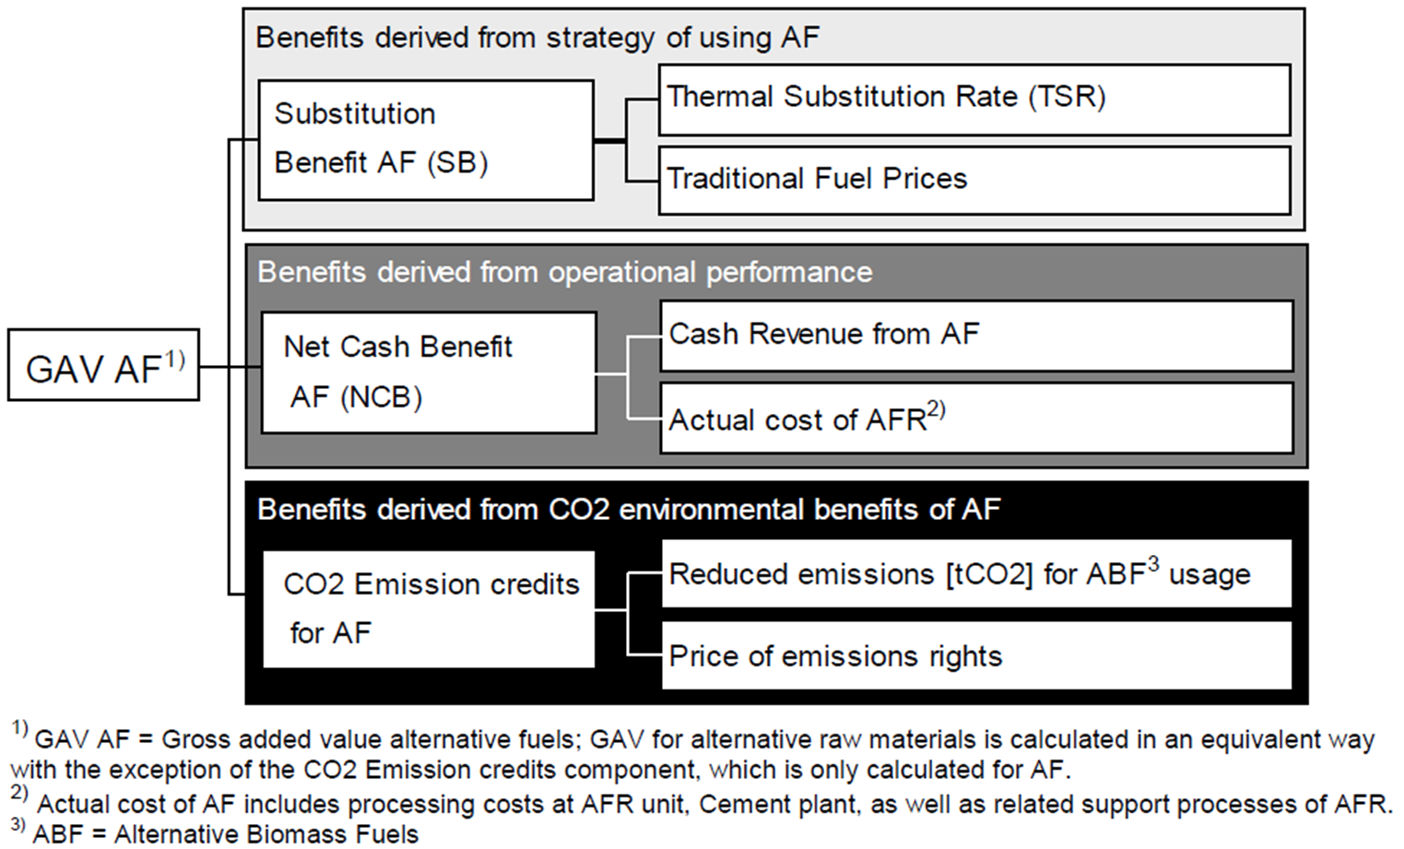
GAV (AF and AR) has two components of value generation, Substitution Benefit (SB) and Net Cash Benefit (NCB)
LHARP defines GAV only OpCo level, not on kiln or plant level

Slide 6
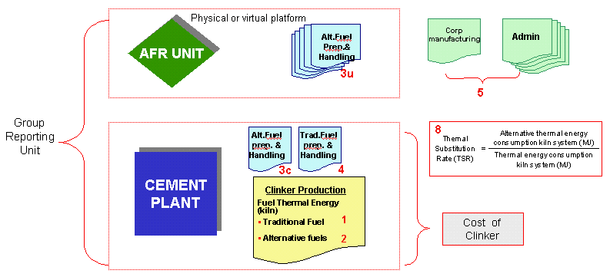
GAV Definition by HARP

Slide 7
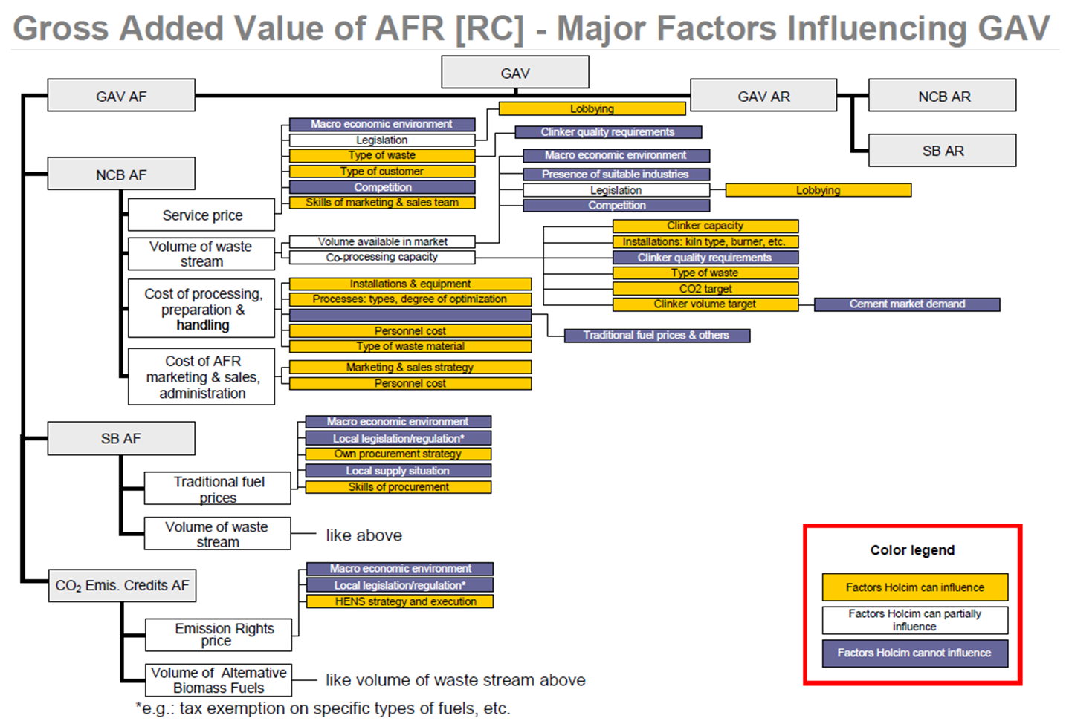

Slide 8
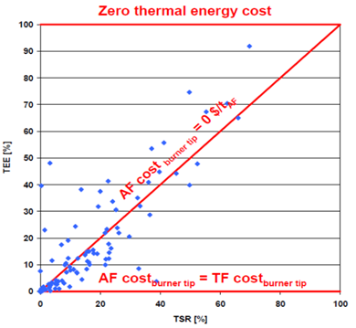


TSR and TEE
HARP defines TSR on kiln level, consolidated on Plant/OpCo/Group level.
TSR corresponds to the relation of thermal energy consumption of alternative fuels to the total amount of thermal energy consumption in the kiln system.
TSR should be looked at in relation with SB. Important to compare specific fuel cost ($/GJ) of AF with traditional fuel.
HARP defines TEE on plant level, consolidated on Plant/OpCo/Group level.
TEE corresponds to the economic benefit derived from using AF by showing
the relationship between the fuel costs and the theoretical fuel costs
(traditional fuels) if no AF were used.
TEE>100% → negative cost for thermal energy
TEE=100% → zero cost for thermal energy
TEE=TSR → zero fuel cost for AF
TEE=0% → AF costs as much as traditional fuels
TEE<0% → AF more expensive than traditional fuels - avoid!!
Important to look at TEE! High TSR alone does not necessarily mean high GAV.
$$TSR, \%= \frac{Energy from alternative fuels for kiln system}{Total thermal energy consumption of kiln system}×100$$
$$TEE, \%=\left[1−\frac{Actual cost of total energy×\left(1−\frac{TSR, \%}{100}\right)}{Actual cost of energy from traditional fuels}\right]×100$$

Slide 9
TEE example: Benefit can be easily calculated!
Production = 3.7 mio t_{cli}/a
SACTE = 14.5 USD/t_{cli} (4.9 USD/GJ)
TSR 23.7%, TEE 14.5%
ACTE = 3.7 mio t_{cli}/a x 14.5 USD/t cli = 53.7 mio USD/a
SACTE = Specific Actual Cost of Thermal Energy
ACTE = Actual Cost of Thermal Energy

Slide 10
Net Cash Benefit is what remains as Revenue at Burner Tip, after subtracting all costs to bring the AF to the burner tip
$$Net Cash Benefit \left[NCB\right]= Fuel Cost at Burner Tip ∗ (−1)$$
Net Cash Benefit (NCB)* =
+ Cash Revenue for Waste / AFR
– Transport Cost Source to Platform
– Pre-Processing Costs at Platform
– Transport Cost Platform to Plant
– Handling/Feeding Cost at Plant
Price Waterfall / Value chain
*) Assuming that Actual Cost of AFR related support processes (marketing, sales, administration) are included in cost below
Example: Value chain

Slide 11
Substitution Benefit (SB)
What is the Substitution Benefit per GJ, if the Traditional Fuel Price is 6 USD/GJ?
6 USD/GJ

Slide 12
GAV = SB + NCB + CO₂ (AF)
If CO₂ (AF) = 0, then
GAV = SB + NCB
GAV = SB – Total AF Cost at Burner Tip
GAV/GJ = Specific TF Cost – Specific AF Cost at Burner Tip

Slide 13
What fuels should we look at to increase GAV?
Typical AF contributing mainly to NCB
Waste water, contaminated soil, FMCG (Unilever, Johnson & Johnson, …), sludges, filter cakes, …
Typical AF contributing mainly to SB
Waste oil, solvents, tyres, rice husk, saw dust (generally „dry“ biomass), charcoal, …
AF contributing to both SB and NCB
Combining above (impregnation of sawdust), RDF?, animal meal, dried sewage sludge, petroleum slugde, …
Tendency for AFR strategy
Cheaper traditional fuel → Target NCB by AF
Expensive traditional fuel → Target NCB+SB by AF

Slide 14
Estimated benefits should be carefully assessed
NCB
Careful that preparation, handling and feeding costs do not ‘eat up’ the NCB
Fuels can have impact on clinker production (process fluctuation, production rate, availability, etc.)
SB
AFs mainly substituting TF should also have good properties (low fluctuations e.g. NCV, H2O, ash, …)
Higher competition → Price trend similar to TFs

Slide 15
Fuel Mix Optimizer

Slide 16
FMO is a very useful tool to evaluate optimal fuel mix and for development of AFR strategy
Technical constraints of kiln system
Waste Market & Permit constraints
+
Optimum Fuel Mix
Alignment of ‘Waste Market’ with ‘Kiln AFR Potentials’

Slide 17
Two business units, different KPIs → do we always get best solution?
AFR Organisation (e.g. Geocycle)
GAV
→ more NCB driven
Cement Plant
Production rate (depending on cement market)
Kiln availability (MTBF)
Specific thermal energy cost ($/GJ)
Specific energy consumption (MJ/t cli)
TSR, TEE
…
→ more SB driven while maintaining smooth clinker production
Successful AFR Strategy requires alignment over KPIs between AFR Organisation and Cement Plants.
FMO requires information from both sides → bridging tool

Slide 18
What is the FMO methodology?
Calculates specific heat consumption with impacts from
TFs
AFs
Kiln gas bypass
Calculates important elements in clinker
SO3
Alkalies (Na2O, K2O)
Ash
…
Calculates GAV/GJ per AFR stream and on kiln / plant level
Required for economic comparison of different AFR types
Evaluates the impact of fuel mix changes on main KPIs
TSR
Actual cost of thermal energy
GAV

Slide 19

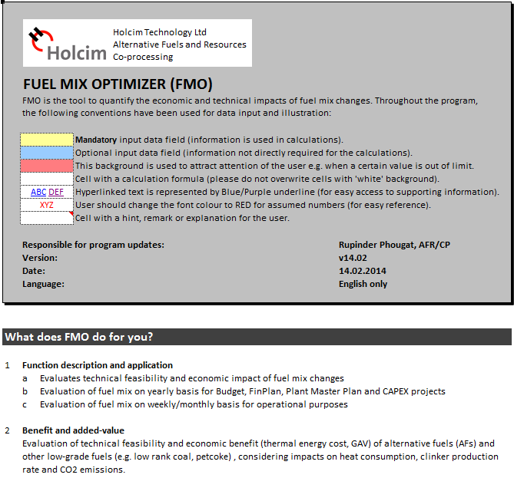
Structure of the FMO tool
Help
What does the FMO do for you?, Definitions and explanations, How to use the FMO?
Baseline
Typically YTD or actual figures from last year
Simulation1
Simulates future situation with ‘optimum’ fuel mix
Summary
Summarises major KPIs and parameters for Baseline and Simulation(s)
Guidelines
Preconditions for AF use, feed-point selection, typical fuel properties, Cl limits and calculation of Cl input from raw materials, etc.

Slide 20
Overview
General project information
Kiln production & clinker data
Gas handling capacity / margins
Fuel volumes / feed point
Fuel cost
Fuel properties
Heat balance Fuel impacts
Chlorine /
O2 increase
Heat / TSR distribution per feedpoint
KPI’s
Process & quality constraints

Slide 21
Basic production / quality information (use Finplan, ATR)
General project information
Kiln and clinker data
Available margins in kiln system
Important!!
Used for the calculation of “net” impact over clinker production

Slide 22
Waste / AF volumes, category and properties on “as fired” basis
Fuel properties on “as fired” basis
Volumes of TF and AF per Firing Point

Slide 23
Possible to adjust impact of O2 increase
Rule of thumb for solid AF (done automatically!)
30%TSR with solid AF → + 1%O2
Guidelines for TFs (done automatically!)
Override calculated increase in O2 based on practical experience, separately for TFs and AFs

Slide 24
Possible to factor in impact of false air from feeding of AFRs
Provision to include influence from up to 5 AFR transport lines
Pneumatic
Pipe diameter 4“ (100 mm)
Pipe diameter 5“ (125 mm)
Pipe diameter 6“ (150 mm)
Pipe diameter 7“ (175 mm)
Pipe diameter 8“ (200 mm)
Airlock
Flap (old)
Flap (new)
Rotary valve

Slide 25
FMO Simulation Results
Impacts on specific heat
Key performance indicators
Chlorine removal
Summary of fuel split
Process & quality parameters

Slide 26
FMO Summary

Slide 27
AF Categories: Principles of combining AFs into categories
FMO can handle many individual fuels but for good overview and interpretation you should define AF categories:
High volume AFR with its own feeding installation can be treated individually (e.g. rice husk installation).
Combining different AFR according to the feeding system (e.g. various lump fuels to kiln inlet, Putzmeister,…).
Combination according to procedure of pre-processing in the platform (e.g. coarse shredded materials, liquid AF going into blending tank, contaminated soil,…).
Combination according to disposal fee (e.g. highly beneficial waste streams as FMCG, pharmaceuticals,…)
→ Categories need to be defined and agreed site-specific. Future AFR streams need to be taken into consideration by defining the categories.
→ Categorization of AFR streams requires summing up volumes and averaging of the properties.

Slide 28

Input parameters - common traps and difficulties
Fuel properties
Analysis not on ‘as fired’ basis e.g. ash content on dry basis, Cl on wet basis, …
GCV → NCV calculation error; calculation of NCV not on ‘as fired’ basis (e.g. TFs)
S and alkalis based on ash content and not overall sample
Average properties and analysis not consistent with values used for Actual, Budget and Finplan (especially NCV)
Insufficient or incorrect properties for new fuel streams
Fuel cost
Allocation of preparation cost to the individual AFR streams
Mistakes in calculation to ‘as fired’ basis
Resulting cost ‘as fired’ (at plant gate + prep/handling cost) not matching with Actual, Budget and Finplan
Preparation/Handling/Feeding cost need to be adapted (in case of modified AFR installations or logistics)
Fuel volumes
Geocycle platform inbound volume not matching consumption in kiln
Volumes not adapted to ‘as fired’ basis e.g. when dried
Process Engineer (cement plant), Platform/Pre-processing Manager (e.g. Geocycle) and AFR Manager should fill out the FMO together to define reasonable AFR categories and for allocation of fuel preparation cost.

Slide 29
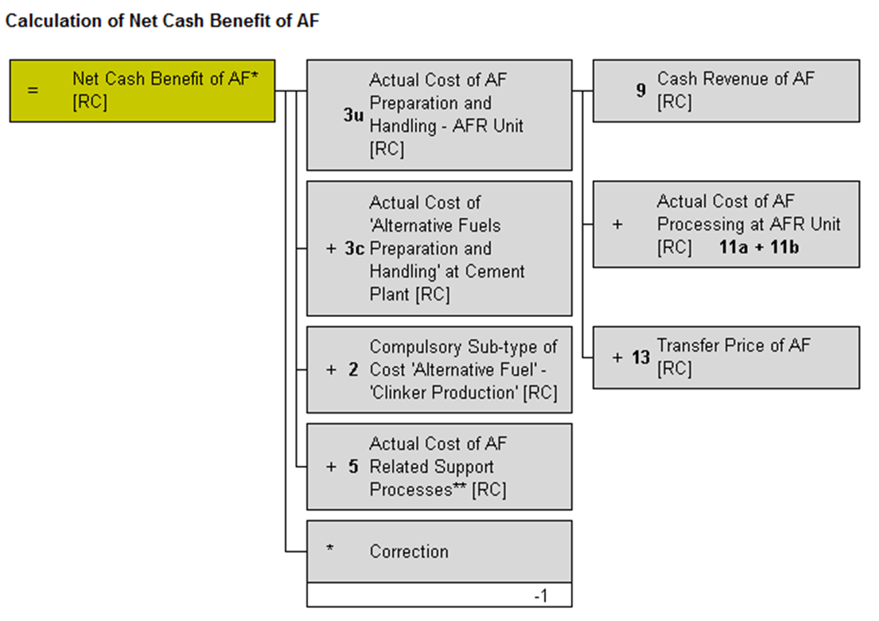
Important to know !!
Actual Cost of AF Related Support Processes should not be included in the costs for AFR entered in the FMO:
Difficult to allocate to individual AF streams
Changing fuel mix (volumes) would drastically change the absolute amount of these costs
The consolidated GAV (calculated by FMO) for various kiln in an OpCo will not match reported GAV → Difference comes from AF related Support Process Costs
Support Process Costs can be entered directly in the KPIs area

Slide 30
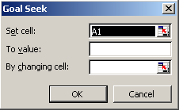
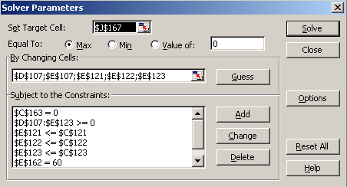
Use Solver to Simulate Fuel Mix Scenarios → Always cross-check results for plausibility !!
Manual optimization
MS Excel “Goal Seek” function
Set cell heat consumption difference (actual vs. target) to value 0 by changing coal consumption
MS Excel Solver add-in
Target Cell:
e.g. Min fuel cost, Max NAV, ...
Constraints
Chlorine input < 300
TSR main firing < 15%
….
→ Sometimes the Solver cannot find a solution (depending on starting values). Set volumes to zero and run Solver again.

Slide 31
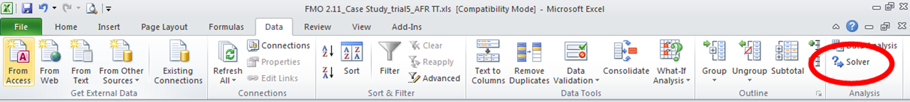
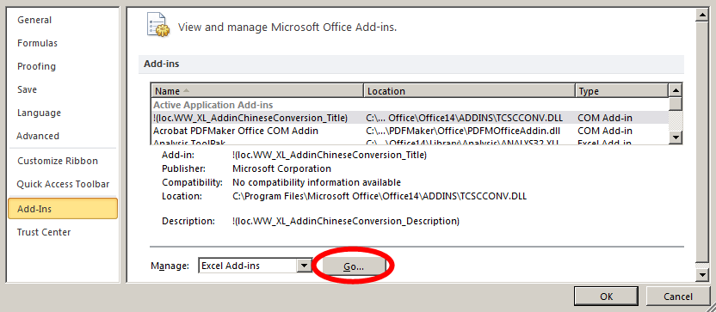
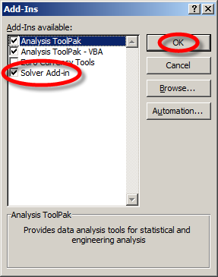
How to enable Solver in Excel?
File →
→ Add-Ins → Go…
→ tick Solver Add-in → OK

Slide 32
Summary / Key messages
Successful AFR Strategy requires aligned KPIs between AFR Organisation and Cement Plants.
Focusing long-term AFR strategy only either on SB or NCB can be risky!!
AF Pre-screening enables the user to filter out ‘unfavourable’ AFs with minimal data input
FMO performs comprehensive evaluation of different fuel mix scenarios. Important to consider the following:
Use it together (AFR organization, Platform and Plant)
Define reasonable categories and pay attention to use realistic values (volumes, preparation cost, waste/fuel properties,…)
Always cross-check the results for plausibility!
Use the results from FMO to define/adapt your strategy (MTP, roadmap,..)

